Slide 1


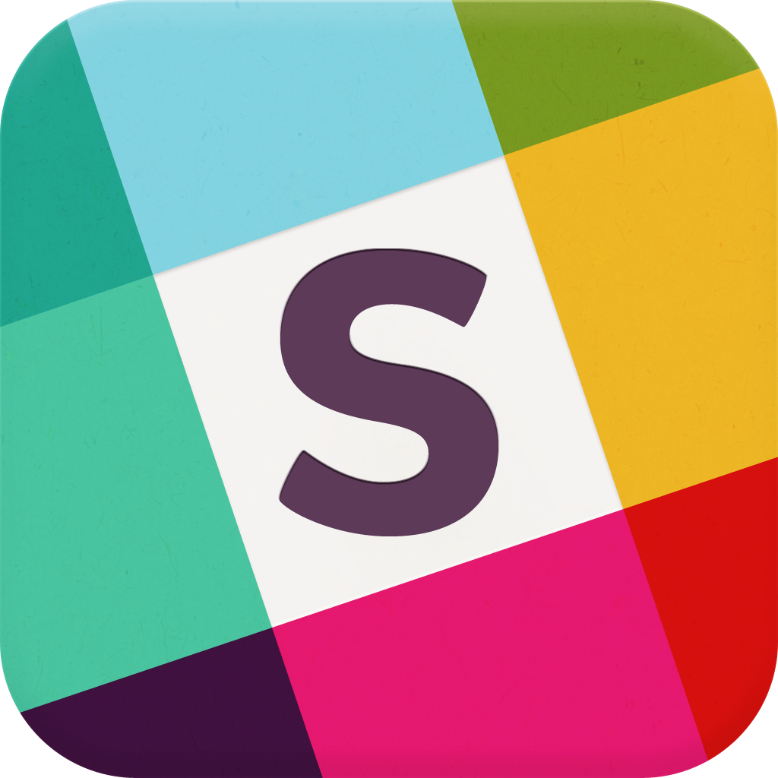
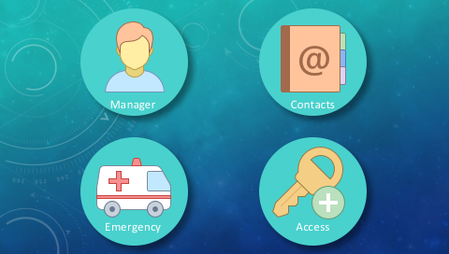
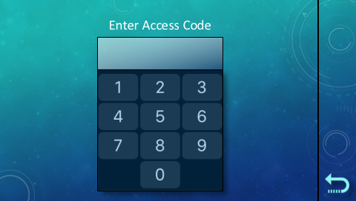
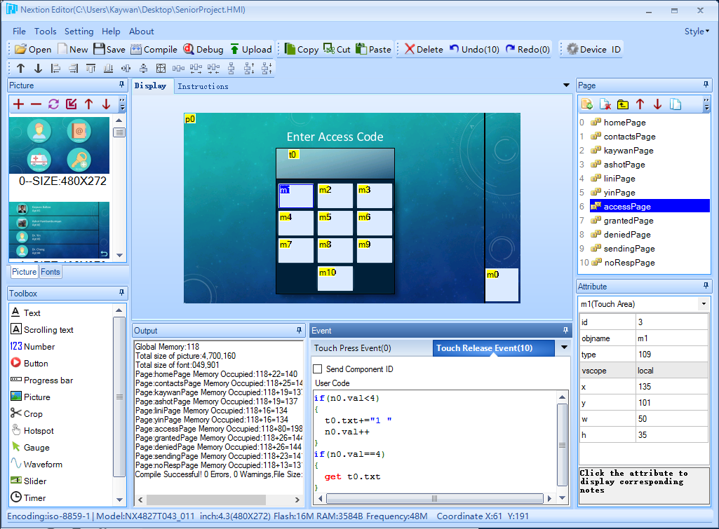
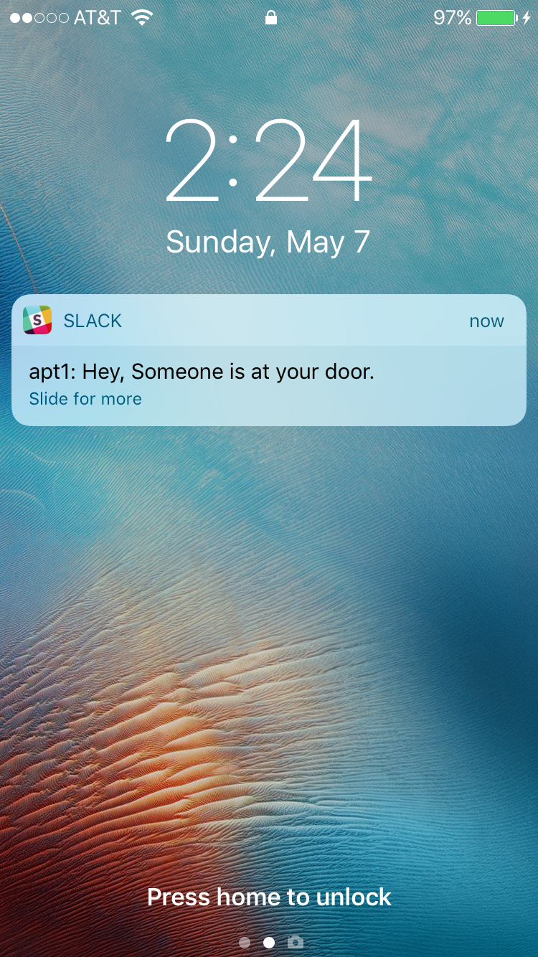
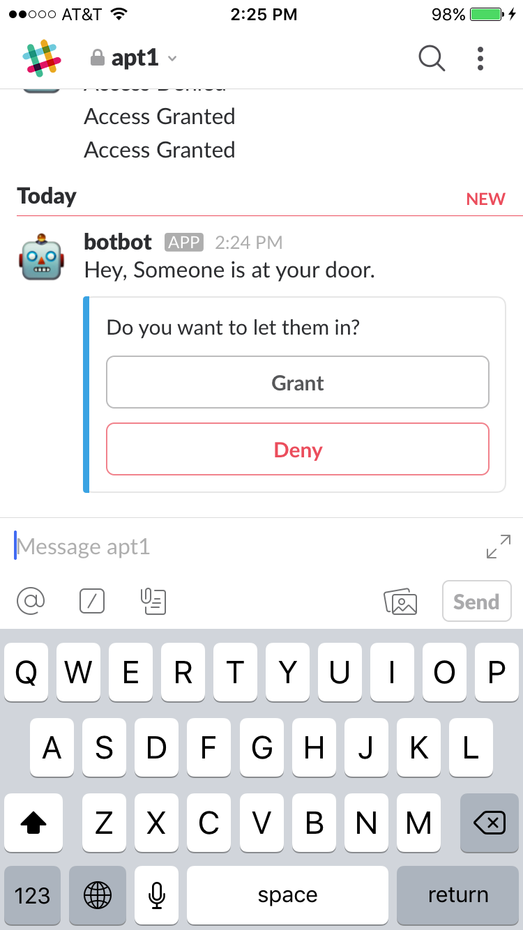
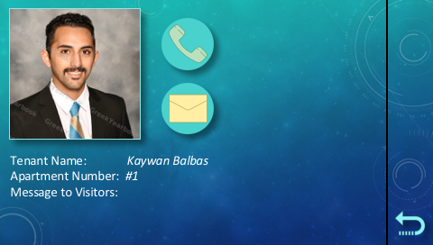
SASBOT
Microcontroller Based Smart Access System
with Slack Bot Assistant
By: Ashot Hambardzumyan and Kaywan Balbas
Advisor: Dr. Yin
Overview:
SASBOT is designed to modernize access systems for buildings and communities. Instead of using archaic technologies, such as land line phones and mechanical keypad interfaces, SASBOT facilitates communication using a touch screen display connected to Wi-Fi. SASBOT provides a simpler and more efficient experience for both guests and tenants.
Push notifications are sent to the tenant’s smart phone through the Slack app. When the app is opened, the tenant will have the option to grant or deny access.
Nextion Editor IDE
These are examples of the SASBOT interface. Shown above is the Home Screen. Below is a tenant’s profile page.
The image shown above was designed using PowerPoint. It was then imported into Nextion Editor (left), where touch areas were added for touch screen functionality. This method was used to create the entire SASBOT user interface.

